Slide 1
Coupling for Qubit
張有義

Slide 2
Outline
Background
Classical case of coupling
Type of coupling
The case of coupling
Case1. Qubit-resonator
Jaynes-Cummings Model
Case2. Qubit-qubit
Strong coupling
Notes:
要講QED的偶合，這邊用classical的偶合去帶出偶合的觀念。

Slide 3
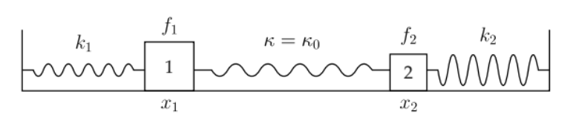
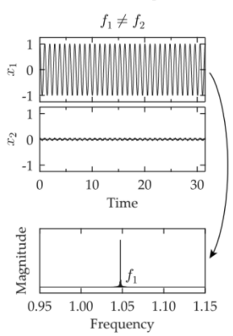
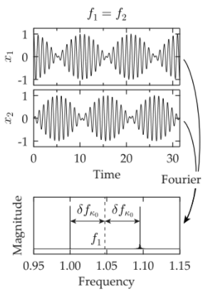

Classical Coupling for two system
In static coupling
The equations of the motion are
$$m_{1}\ddot{x_{1}}=−\left(k_{1}+κ_{0}\right)x_{1}+k_{2}x_{2}$$
$$m_{2}\ddot{x_{2}}=−\left(k_{2}+κ_{0}\right)x_{2}+k_{1}x_{1}$$
The Hamiltonian of the motion is
$$\hat{H}=\frac{p_{1}^{2}}{2m_{1}}+\frac{k_{1}+κ_{0}}{2}x_{1}^{2}+\frac{p_{2}^{2}}{2m_{2}}+\frac{k_{2}+κ_{0}}{2}x_{2}^{2}−κ_{0}x_{1}x_{2}$$
Fourier transform
Notes:
首先是classical mechanics 中，係數無時變的情況下。只有f_1=f_2時，兩個系統才會相互偶合。

Slide 4
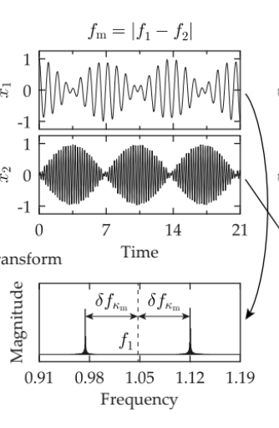

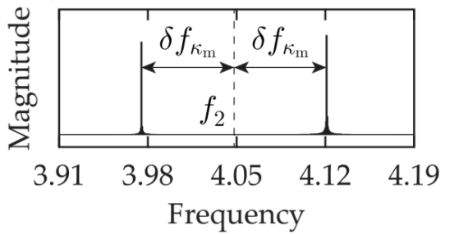
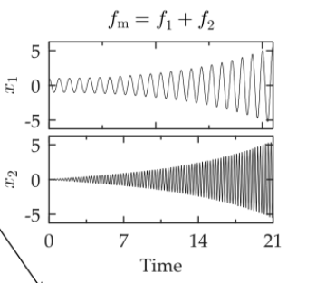

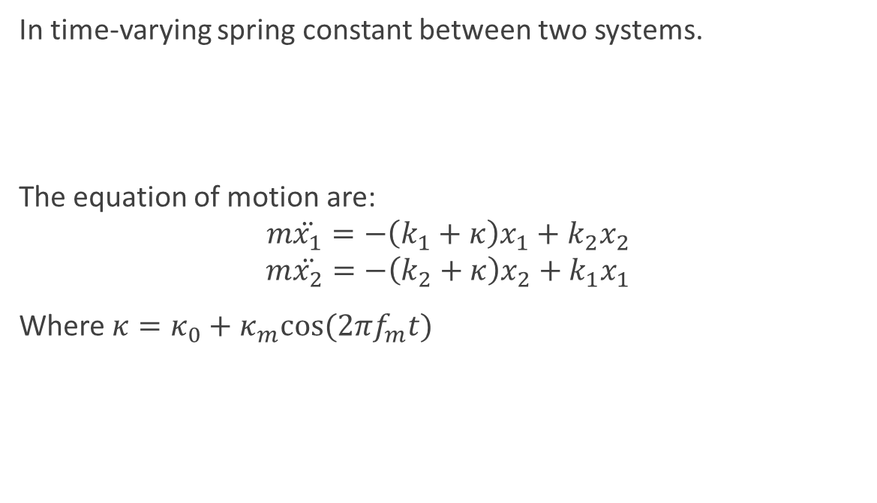

In time-varying spring constant between two systems.
The equation of motion are:
$$m\ddot{x_{1}}=−\left(k_{1}+κ\right)x_{1}+k_{2}x_{2}$$
$$m\ddot{x_{2}}=−\left(k_{2}+κ\right)x_{2}+k_{1}x_{1}$$
Where $κ=κ_{0}+κ_{m}cos⁡(2πf_{m}t)$
$$f_{1}$$
$$f_{1}$$
Notes:
這邊的解釋是，如何在兩個system不同的frequency之下，還能夠偶合

Slide 5
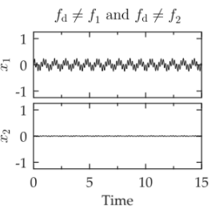
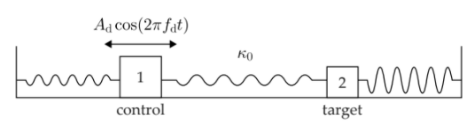
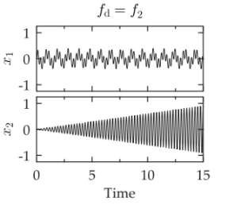
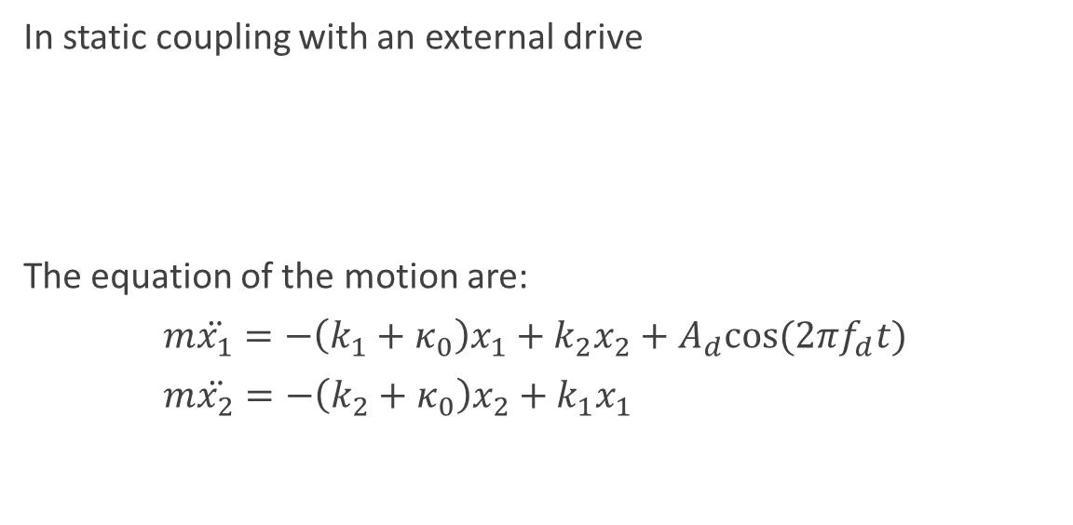
In static coupling with an external drive
The equation of the motion are:
$m\ddot{x_{1}}=−\left(k_{1}+κ_{0}\right)x_{1}+k_{2}x_{2}+A_{d}cos⁡(2πf_{d}t)$
$m\ddot{x_{2}}=−\left(k_{2}+κ_{0}\right)x_{2}+k_{1}x_{1}$

Slide 6

In Quantum Electrodynamics
We should consider the system is fermionic or bosonic.
Fermions: they follow Fermi–Dirac statistics and generally has half odd integer spin.
Bosons: They follow the Bose-Einstein statistics and generally has integer spin.
$$\hat{H}={\hat{H}}_{1}+{\hat{H}}_{2}+{\hat{H}}_{int}$$
$${\hat{H}}_{int}=ħg_{x} {\hat{σ}}_{x}{\hat{A }}_{1}+ħg_{z} {\hat{σ}}_{z}{\hat{A }}_{2}$$
Transverse coupling
Longitudinal coupling

Slide 7
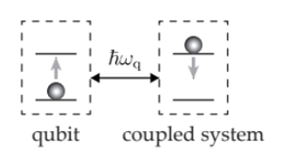
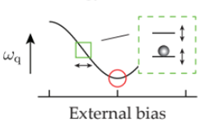
Transverse and Longitudinal Coupling
Transverse coupling
1. Exchanging energy
2. Depolarizing
3. Being effective when the frequency of coupled system is close to qubit’s.
Longitudinal Coupling
1. Shifting the energy levels with external bias
2. Changing the qubit’s frequency
2. Dephasing

Slide 8
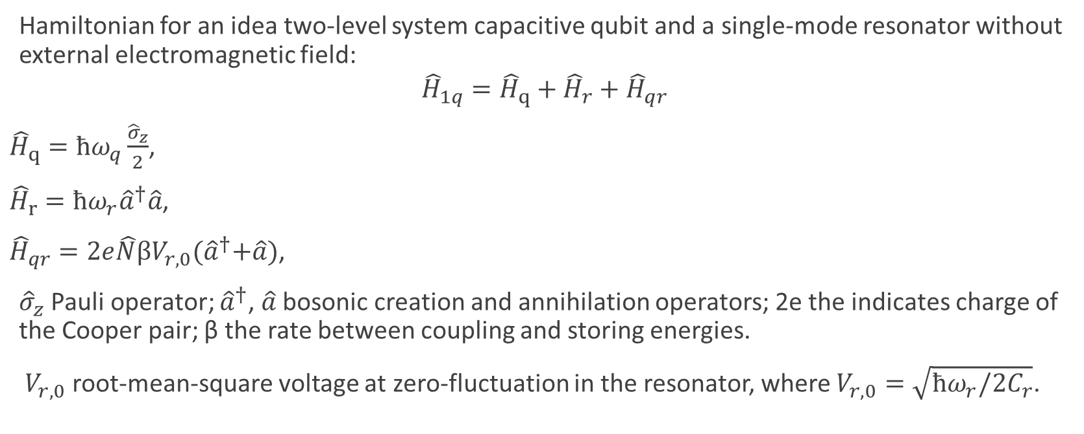
Case 1.
Hamiltonian for an idea two-level system capacitive qubit and a single-mode resonator without external electromagnetic field:
$${\hat{H}}_{1q}={\hat{H}}_{q}+{\hat{H}}_{r}+{\hat{H}}_{qr}$$
${\hat{H}}_{q}=ħω_{q}\frac{{\hat{σ}}_{z}}{2}$,
${\hat{H}}_{r}=ħω_{r}{\hat{a}}^{†}\hat{a}$,
${\hat{H}}_{qr}=2e\hat{N}βV_{r,0}{(\hat{a}}^{†}+\hat{a})$,
${\hat{σ}}_{z}$ Pauli operator; ${\hat{a}}^{†}$, $\hat{a}$ bosonic creation and annihilation operators; 2e the indicates charge of the Cooper pair; β the rate between coupling and storing energies.
$V_{r,0}$ root-mean-square voltage at zero-fluctuation in the resonator, where $V_{r,0}=\sqrt{ħω_{r}/2C_{r}}$.

Slide 9

$${\hat{H}}_{qr}=2e\hat{N}βV_{r,0}{(\hat{a}}^{†}+\hat{a})$$
Defining that
$$ħg_{ij}=2eβV_{r,0}\left\langle i | \hat{N} | j\right\rangle$$
substitute it into ${\hat{H}}_{qr}$
$${\hat{H}}_{qr}=ħ\sum_{i,j}{g_{ij} \left.\left|i\right.\right\rangle \left\langle \left.j\right|\right.{(\hat{a}}^{†}+\hat{a}) }$$
and we can got
$${\hat{H}}_{qr}=ħ(g_{x}{\hat{σ}}_{x}+g_{z}{\hat{σ}}_{z}){(\hat{a}}^{†}+\hat{a})$$
$$g_{x}≡g_{01}=g_{01}$$
$$g_{z}≡\frac{g_{00}−g_{11}}{2}$$
Here, frequency of qubit is independent on the voltage.

Slide 10
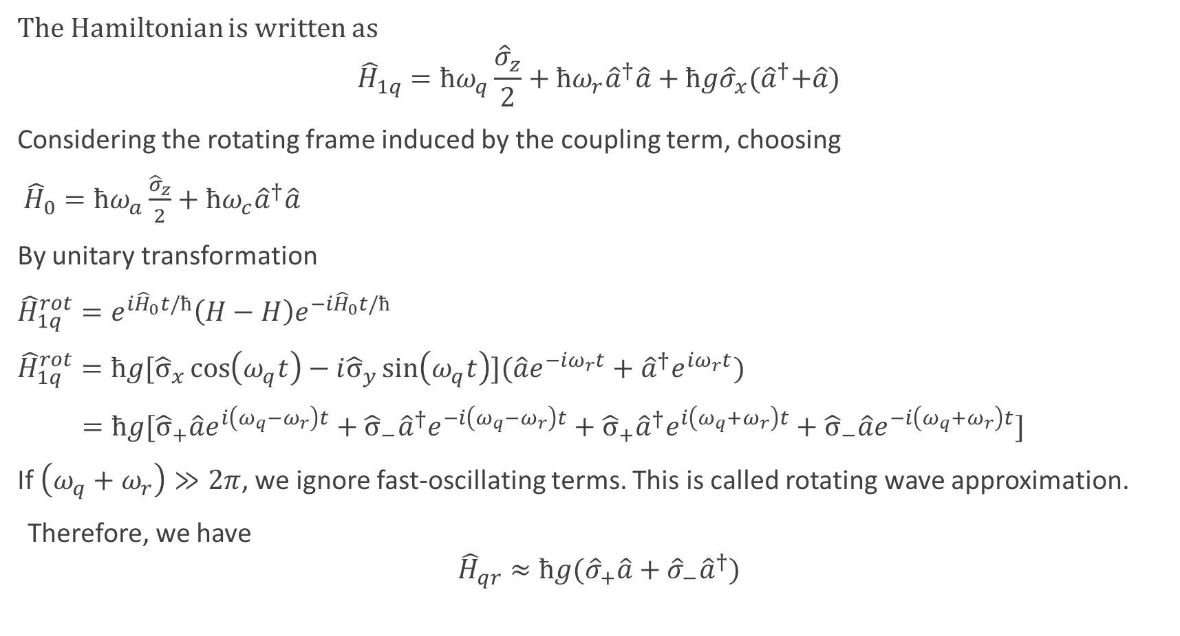
The Hamiltonian is written as
$${\hat{H}}_{1q}=ħω_{q}\frac{{\hat{σ}}_{z}}{2}+ħω_{r}{\hat{a}}^{†}\hat{a}+ħg{\hat{σ}}_{x}{(\hat{a}}^{†}+\hat{a})$$
Considering the rotating frame induced by the coupling term, choosing
${\hat{H}}_{0}=ħω_{a}\frac{{\hat{σ}}_{z}}{2}+ħω_{c}{\hat{a}}^{†}\hat{a}$
By unitary transformation
${\hat{H}}_{1q}^{rot}=e^{i{\hat{H}}_{0}t/ħ}\left(H−H\right)e^{−i{\hat{H}}_{0}t/ħ}$
${\hat{H}}_{1q}^{rot}=ħg[{\hat{σ}}_{x}\cos\left(ω_{q}t\right)−i{\hat{σ}}_{y}\sin\left(ω_{q}t\right)](\hat{a}e^{−iω_{r}t}+{\hat{a}}^{†}e^{iω_{r}t})$
$=ħg[{\hat{σ}}_{+}\hat{a}e^{i\left(ω_{q}−ω_{r}\right)t}+{{\hat{σ}}_{−}\hat{a}}^{†}e^{−i\left(ω_{q}−ω_{r}\right)t}+{{\hat{σ}}_{+}\hat{a}}^{†}e^{i\left(ω_{q}+ω_{r}\right)t}+{\hat{σ}}_{−}\hat{a}e^{−i\left(ω_{q}+ω_{r}\right)t}]$
If $\left(ω_{q}+ω_{r}\right)≫2π$, we ignore fast-oscillating terms. This is called rotating wave approximation.
Therefore, we have
$${\hat{H}}_{qr}≈ħg({\hat{σ}}_{+}\hat{a}+{\hat{σ}}_{−}{\hat{a}}^{†})$$

Slide 11
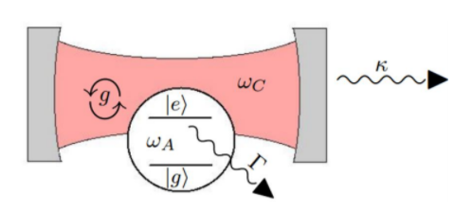
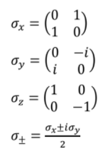

Jaynes-Cummings Model
$${\hat{H}}_{JC}={\hat{H}}_{cavity}+{\hat{H}}_{atom}+{\hat{H}}_{int}$$
$${\hat{H}}_{cavity}=ħω_{c}{\hat{a}}^{†}\hat{a}$$
$${\hat{H}}_{atom}=ħω_{a}\frac{{\hat{σ}}_{z}}{2}$$
$${\hat{H}}_{int}=ħg{(\hat{a}}^{†}+\hat{a})(σ_{+}+σ_{−})$$
In this case,
${\hat{H}}_{JC}=ħω_{q}\frac{{\hat{σ}}_{z}}{2}+ħω_{r}{\hat{a}}^{†}\hat{a}+ħg({\hat{σ}}_{+}\hat{a}+{\hat{σ}}_{−}{\hat{a}}^{†})$

Slide 12

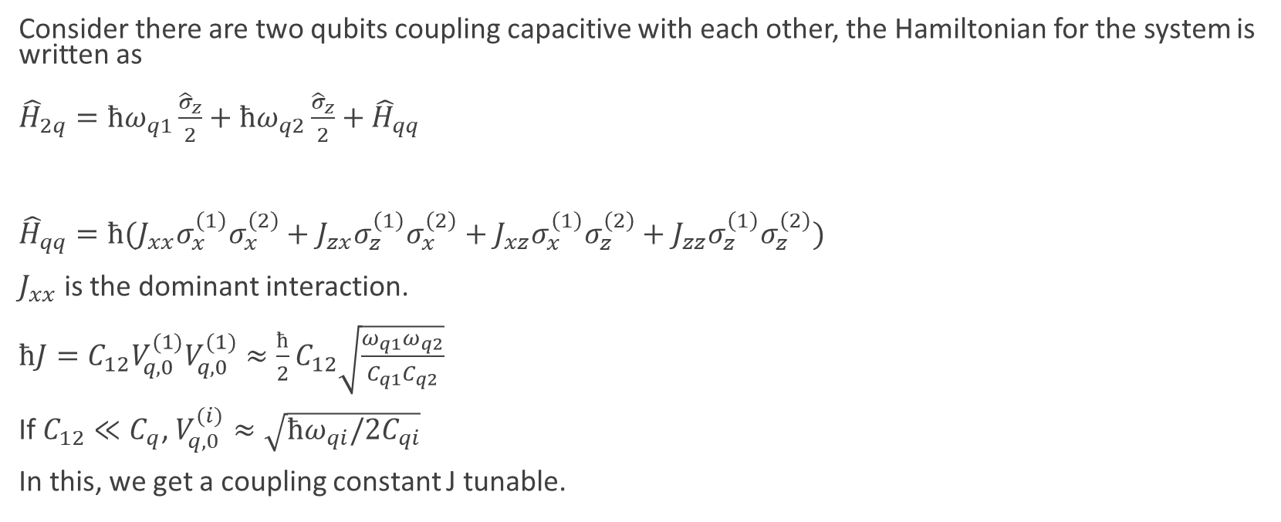
Case 2.
Consider there are two qubits coupling capacitive with each other, the Hamiltonian for the system is written as
${\hat{H}}_{2q}=ħω_{q1}\frac{{\hat{σ}}_{z}}{2}+ħω_{q2}\frac{{\hat{σ}}_{z}}{2}+{\hat{H}}_{qq}$
${\hat{H}}_{qq}=ħ(J_{xx}σ_{x}^{\left(1\right)}σ_{x}^{\left(2\right)}+J_{zx}σ_{z}^{\left(1\right)}σ_{x}^{\left(2\right)}+J_{xz}σ_{x}^{\left(1\right)}σ_{z}^{\left(2\right)}+J_{zz}σ_{z}^{\left(1\right)}σ_{z}^{\left(2\right)})$
$J_{xx}$ is the dominant interaction.
$ħJ=C_{12}V_{q,0}^{(1)}V_{q,0}^{(1)}≈\frac{ħ}{2}C_{12}\sqrt{\frac{ω_{q1}ω_{q2}}{C_{q1}C_{q2}}}$
If $C_{12}≪C_{q}$, $V_{q,0}^{(i)}≈\sqrt{ħω_{qi}/2C_{qi}}$
In this, we get a coupling constant J tunable.

Slide 13
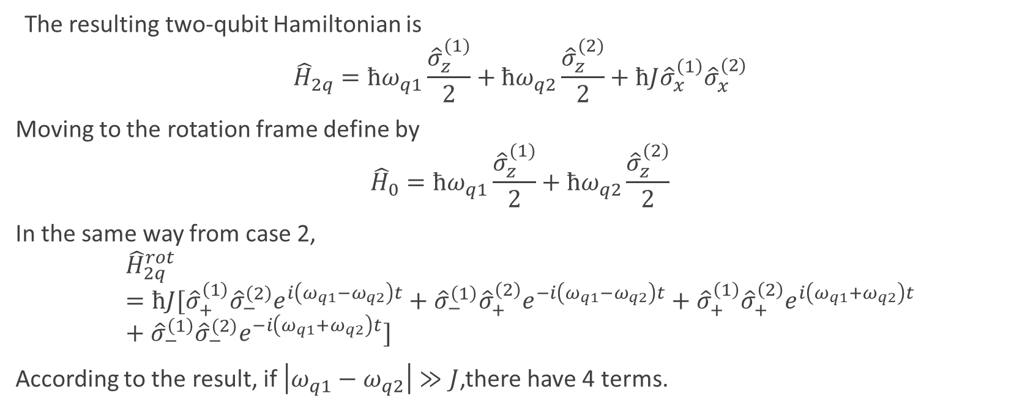
The resulting two-qubit Hamiltonian is
$${\hat{H}}_{2q}=ħω_{q1}\frac{{\hat{σ}}_{z}^{(1)}}{2}+ħω_{q2}\frac{{\hat{σ}}_{z}^{(2)}}{2}+ħJ{\hat{σ}}_{x}^{\left(1\right)}{\hat{σ}}_{x}^{(2)}$$
Moving to the rotation frame define by
$${\hat{H}}_{0}=ħω_{q1}\frac{{\hat{σ}}_{z}^{(1)}}{2}+ħω_{q2}\frac{{\hat{σ}}_{z}^{(2)}}{2}$$
In the same way from case 2,
$${\hat{H}}_{2q}^{rot}=ħJ[{\hat{σ}}_{+}^{\left(1\right)}{\hat{σ}}_{−}^{\left(2\right)}e^{i\left(ω_{q1}−ω_{q2}\right)t}+{\hat{σ}}_{−}^{\left(1\right)}{\hat{σ}}_{+}^{\left(2\right)}e^{−i\left(ω_{q1}−ω_{q2}\right)t}+{\hat{σ}}_{+}^{\left(1\right)}{\hat{σ}}_{+}^{\left(2\right)}e^{i\left(ω_{q1}+ω_{q2}\right)t}+{\hat{σ}}_{−}^{\left(1\right)}{\hat{σ}}_{−}^{(2)}e^{−i\left(ω_{q1}+ω_{q2}\right)t}]$$
According to the result, if $\left|ω_{q1}−ω_{q2}\right|≫J$,there have 4 terms.

Slide 14
Thank you for listening!

